Slide 1
ROBOISM – ATULYA – IOT
NAME: BRIJ MOHAN SINGH
BRANCH: ELECTRICAL ENGINEERING ( IIT ISM DHANBAD )

Slide 2
HOME SECURITY
In this project, we are detecting if somebody is trying to thief a house by breaking the door or window. Basically, we are using three types of sensors in this project PIR Sensor, IR Sensor, Vibration Sensor.

Slide 3
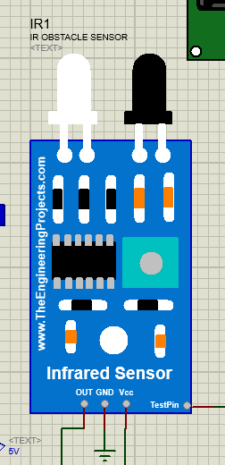
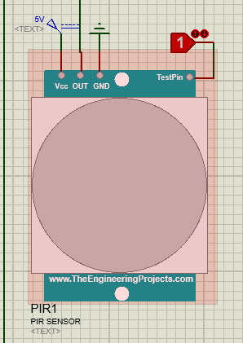
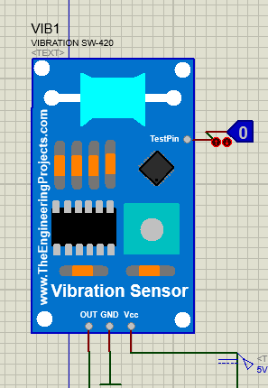
SENSORS USED
PIR SENSOR – Detects if somebody is moving
IR SENSOR – Detects if somebody is standing in front of door
VIBRATION – Detects if somebody trying to break the windows or door

Slide 4
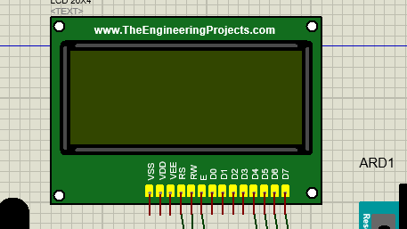
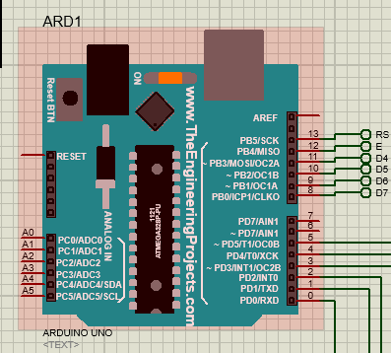
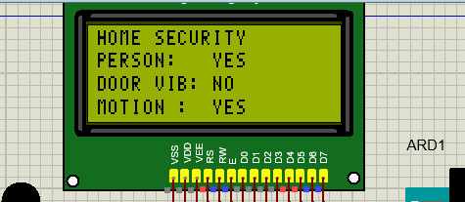
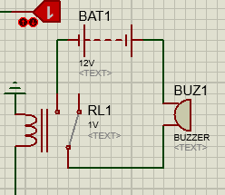
OTHER DEVICES USED
LCD DISPLAY – Used to display different things
ARDUINO - Brain
BUZZER + RELAY – Relay used to turn on the buzzer circuit at very small current from Arduino

Slide 5
DISCRIPTION
We take three different inputs from three different sensors ( IR , PIR, and Vibration) to detect if a thief is coming.
Using an IR sensor we know if somebody is standing. By detecting motion from the PIR sensor we get confirmed about a human being (THIEF).
By Vibration sensor, we know that somebody is trying to break the door or window.
We get confirmed about the theft. Now we will turn on the buzzer if we get true value from all three sensors.

Slide 6
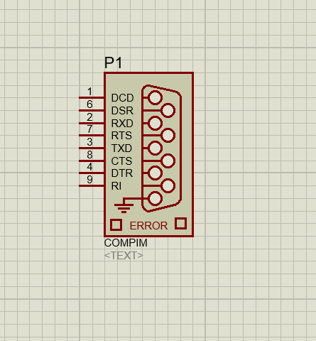
SCOPE
We tried to connect the data to on BLYNK server. But due to some unknown error, it was not possible. We used the Serial Communication app and COMPIM module of proteus.
After uploading the data, we can use it to send messages to the owner and police station.
We will wait for 15 seconds if the vibration continue then send it to the police station

Slide 7
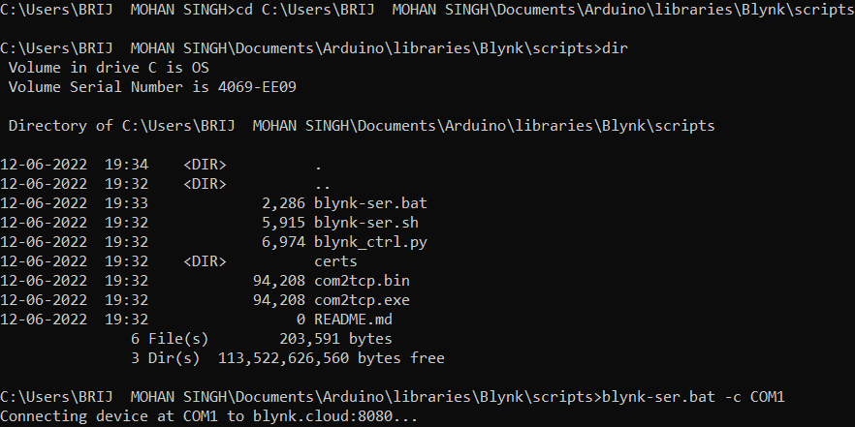

Slide 8
FURTHER IMPROVEMents
If somehow the thief is successful in breaking the window or door we can catch him inside by spreading a gas which can make him unconscious so that he can be held by police.
We can use GPS sensor to send the location of place to nearest police station.

Slide 9
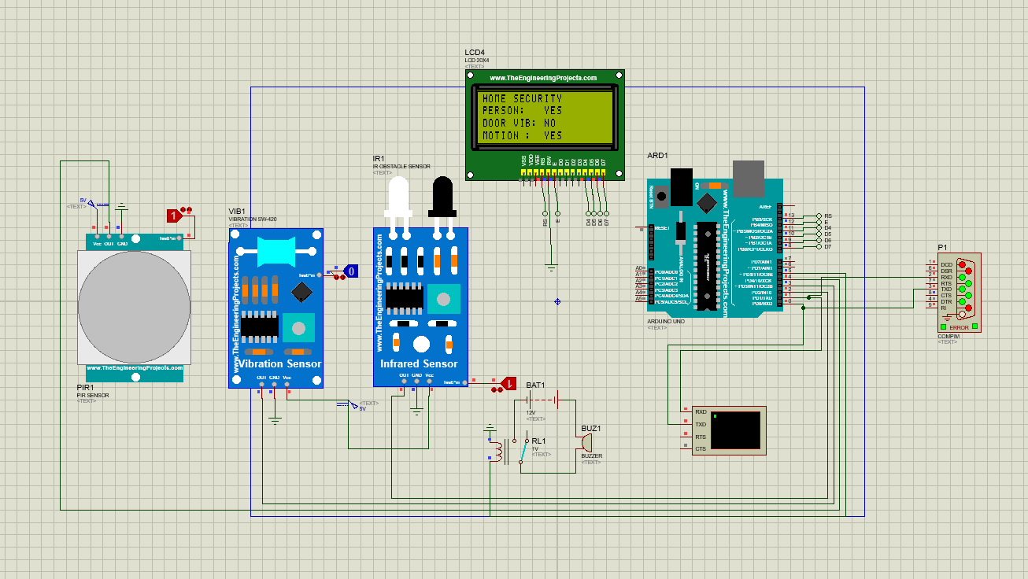

Slide 10
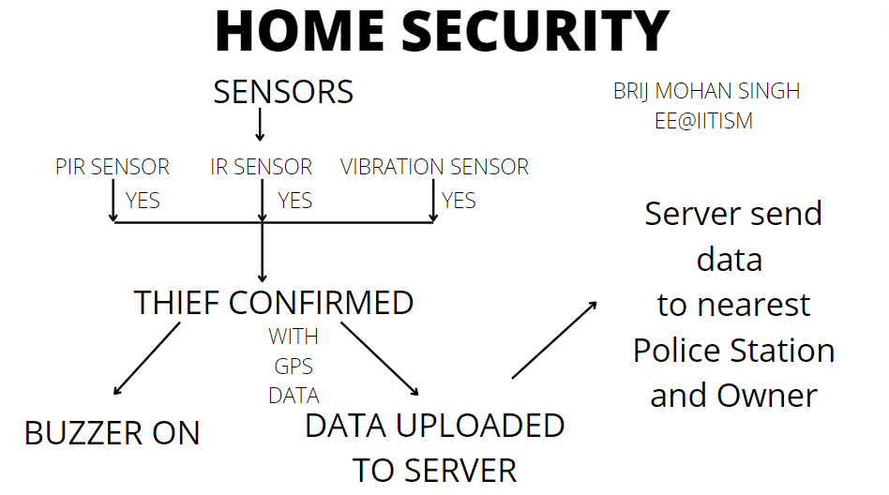
BLOCK DIAGRAM

